Slide 1

Mary, Queen of the Family Parish
is a welcoming, diverse, multicultural, Catholic community.
We seek to live, teach and share the joy of the Gospel;
to grow as disciples of Jesus through prayer, witness and action
and to respond to the needs of the family in the Blacktown community and beyond.
Notes:
Saturday 5.30PM First Sunday of Advent
16th Sunday in Ord Time Year B

Slide 2
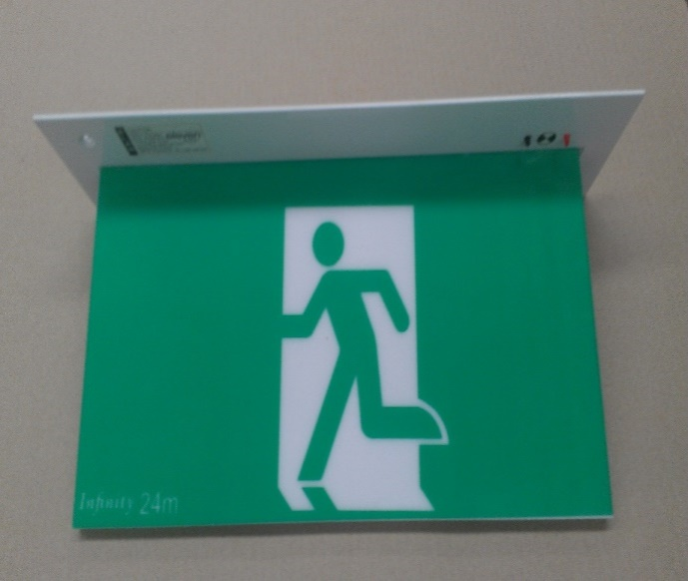
SAFETY MESSAGE
Please take a moment to
identify your closest exit.
There will be an announcement if we need to evacuate the building.
Evacuate the building via the nearest Exit & proceed directly to the footpath along Orwell Street.
DO NOT move any vehicles or remain in the car park.

Slide 3
Mary, Queen of the Family Parish
is a welcoming, diverse, multicultural, Catholic community.
We seek to live, teach and share the joy of the Gospel;
to grow as disciples of Jesus through prayer, witness and action
and to respond to the needs of the family in the Blacktown community and beyond.
Notes:
Saturday 5.30PM First Sunday of Advent
16th Sunday in Ord Time Year B

Slide 4
SAFETY MESSAGE
Please take a moment to
identify your closest exit.
There will be an announcement if we need to evacuate the building.
Evacuate the building via the nearest Exit & proceed directly to the footpath along Orwell Street.
DO NOT move any vehicles or remain in the car park.

Slide 5

Welcome to our Parish …
2nd Sunday Ordinary Time
You have entered a SACRED SPACE ... A SACRED TIME…
Please ensure all mobile phones are switched off.
Please be respectfully quiet as we prepare for our Celebration.
Notes:
Saturday 5.30PM First Sunday of Advent
16th Sunday in Ord Time Year B

Slide 6
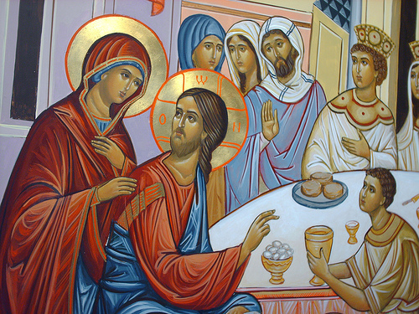
There was a wedding in Cana and Galilee. Mary, mother of Jesus said to him, ‘They have no wine.’
Notes:
16th Sunday in Ord Time Year B

Slide 7
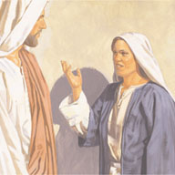
Jesus said, ‘Woman, why turn to me? My hour has not come yet.’ His mother said to the servants, ‘Do whatever he tells you.’
Notes:
16th Sunday in Ord Time Year B

Slide 8
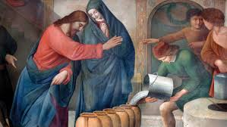
Jesus said to the servants, ‘Fill the jars with water,’ and they filled them to the brim. ‘
Notes:
16th Sunday in Ord Time Year B

Slide 9
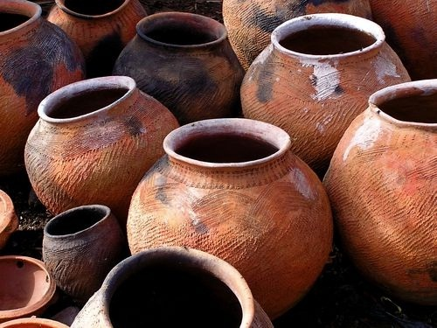
‘Do whatever he tells you…’
What is my response?
Notes:
16th Sunday in Ord Time Year B

Slide 10
PLEASE STAND

Slide 11
ENTRANCE ANTIPHON
All the earth shall bow down before you, O God, and shall sing to you, shall sing to your name, O Most High!
The English translation of The Roman Missal © 2010,
International Commission on English in the Liturgy Corporation. All rights reserved.

Slide 13
Penitential Act
Lord have mercy. Lord have mercy.
Christ have mercy. Christ have mercy.
Lord have mercy. Lord have mercy.
The English translation of The Roman Missal © 2010,
International Commission on English in the Liturgy Corporation. All rights reserved.

Slide 15
GLORIA
Glory to God in the highest,
and on earth peace to people of good will.
We praise you, we bless you,
we adore you, we glorify you,
we give you thanks for your great glory,
Lord God, heavenly King,
O God, almighty Father.

Slide 16
Lord Jesus Christ, Only Begotten Son,
Lord God, Lamb of God, Son of the Father,
you take away the sins of the world,
have mercy on us;
you take away the sins of the world,
receive our prayer;
you are seated at the right hand of the Father, have mercy on us.

Slide 17
For you alone are the Holy One,
you alone are the Lord,
you alone are the Most High, Jesus Christ, with the Holy Spirit,
in the glory of God the Father.
Amen.
The English translation of The Roman Missal © 2010,
International Commission on English in the Liturgy Corporation. All rights reserved.

Slide 19

Responsorial Psalm
1. (R.)
2. Proclaim his help day by day,
tell among the nations his glory
and his wonders among all the peoples. (R.)
3. Give the Lord, you families of peoples,
give the Lord glory and power,
give the Lord the glory of his name. (R.)
4. Worship the Lord in his temple.
O earth, tremble before him.
Proclaim to the nations: ‘God is king.’
He will judge the peoples in fairness. (R.)
Proclaim his marvellous deeds to all the nations.

Slide 20
O sing a new song to the Lord,
sing to the Lord all the earth.
O sing to the Lord, bless his name..
Proclaim his marvellous deeds to all the nations.

Slide 21
Proclaim his help day by day,
tell among the nations his glory
and his wonders among all the peoples.
Proclaim his marvellous deeds to all the nations.

Slide 22
Give the Lord, you families of peoples,
give the Lord glory and power,
give the Lord the glory of his name.
Proclaim his marvellous deeds to all the nations.

Slide 23
Worship the Lord in his temple.
O earth, tremble before him.
Proclaim to the nations: ‘God is king.’
He will judge the peoples in fairness.
Proclaim his marvellous deeds to all the nations.

Slide 24


Slide 25
Gospel Acclamation
Alleluia, alleluia!
God has called us with the gospel
to share in the glory of our Lord Jesus Christ.
Alleluia!

Slide 27
APOSTLES’ CREED
I believe in God,
the Father almighty,
Creator of heaven and earth,
and in Jesus Christ, his only Son, our Lord,
(At the words that follow, up to and including the Virgin Mary, all bow.)
who was conceived by the Holy Spirit,
born of the Virgin Mary,
suffered under Pontius Pilate,
was crucified, died and was buried;
he descended into hell;

Slide 28
on the third day he rose again from the dead;
he ascended into heaven,
and is seated at the right hand
of God the Father almighty;
from there he will come to judge
the living and the dead.
I believe in the Holy Spirit,
the holy catholic Church,
the communion of saints,
the forgiveness of sins,
the resurrection of the body,
and life everlasting. Amen.

Slide 30
First Collection
This collection goes to the Bishop
for the support of the Diocese.
Thank you for your contribution

Slide 32
Holy, Holy, Holy
Holy, Holy, Holy Lord God of hosts,
Heaven and earth are full of your glory.
Hosanna in the highest
Blessed is he who comes
in the name of Lord,
Hosanna in the highest.
The English translation of The Roman Missal © 2010,
International Commission on English in the Liturgy Corporation. All rights reserved.

Slide 34
Save us, Saviour of the world,
for by your Cross
and Resurrection
you have set us free.
Memorial Acclamation
We proclaim your Death, O Lord,
and profess your Resurrection
until you come again.
When we eat this Bread and drink this Cup, we proclaim your Death,
O Lord, until you come again.
The English translation of The Roman Missal © 2010,
International Commission on English in the Liturgy Corporation. All rights reserved.
Notes:
Sunday 10AM First Sunday of Advent
7am - 14th Sunday in Ord Time
16th Sunday in Ord Time Year B

Slide 36
Amen
When we eat this Bread and drink this Cup, we proclaim your Death,
O Lord, until you come again.
Amen
We proclaim your Death, O Lord,
and profess your Resurrection
until you come again.
The English translation of The Roman Missal © 2010,
International Commission on English in the Liturgy Corporation. All rights reserved.
Notes:
Sunday 10AM First Sunday of Advent
7am - 14th Sunday in Ord Time
16th Sunday in Ord Time Year B

Slide 38
Lamb of God
Lamb of God, you take away the sins of the world, have mercy on us.
Lamb of God, you take away the sins of the world, have mercy on us.
Lamb of God, you take away the sins of the world, grant us peace.
The English translation of The Roman Missal © 2010,
International Commission on English in the Liturgy Corporation. All rights reserved.

Slide 40
COMMUNION ANTIPHON
You have prepared a table before me,
and how precious is the chalice that quenches my thirst.
The English translation of The Roman Missal © 2010,
International Commission on English in the Liturgy Corporation. All rights reserved.

Slide 42
Second Collection
What you contribute now
is for the support of our
parish and its mission.
Thank you for your generosity

Slide 43
Parish Office is open
9.00am – 12.00 Noon
(Mon – Fri) St Patrick’s
9.00am -12.00Noon
(Sunday) St Michael’s
USE AFTERHOURS NUMBER TO CONTACT PRIEST

Slide 44


OASIS – MYSTERY BOX CHALLENGE
SUNDAY 24 JANUARY after 9.30am Mass
Fr Sid Moseley Meeting Room (St Michael’s)
Cost $10 (Ages 15 +)

Slide 45
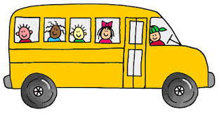
JEAN & BETTY’S BUS TOURS
Tuesday 9 February
Depart 9.00am St Patrick’s Church
BASS & FLINDERS CRUISE
on the Georges River
Cost: $65.00
…includes Bus, Cruise, Morning Tea and Lunch
For more information and to book contact Jean on 99203401 or 0425251754

Slide 46
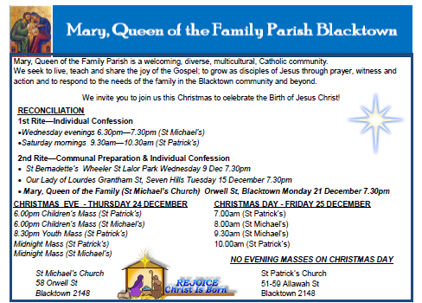



www.mqofblacktown.org.au
    www.facebook.com/blacktowncatholics
@mqofblacktown

Slide 48
‘Do whatever he tells you…’
What is my response?
Notes:
16th Sunday in Ord Time Year B

